Slide 1
Drug Overdose Prevention & Harm Reduction

Slide 2
What are RCORP and SCOPE-OK?
RCORP is a $298 million, multi-year grant initiative supported by Health Resources and Services Administration (HRSA) to address barriers to access in rural communities related to substance use disorder (SUD), particularly Opioid Use Disorder (OUD)
The Southcentral Consortium for Overdose Prevention and Education in Oklahoma (SCOPE-OK) will work to address barriers to the prevention, treatment, and recovery of opioid and other substance disorders.

Slide 3
SCOPE-OK Consortium
SCOPE-OK meets the 2nd Month each quarter (February, May, August, November)– Ardmore Public Library 10 AM-12 PM
Members include:
Groups focused on rural, preventative, and/or public health
Healthcare providers from all settings of care
Educators and school system representatives
Organizations involved with the prevention, treatment, and recovery of substance use
Persons directly impacted by substance use (persons in recovery, impacted family members, persons who use drugs, etc.)

Slide 4
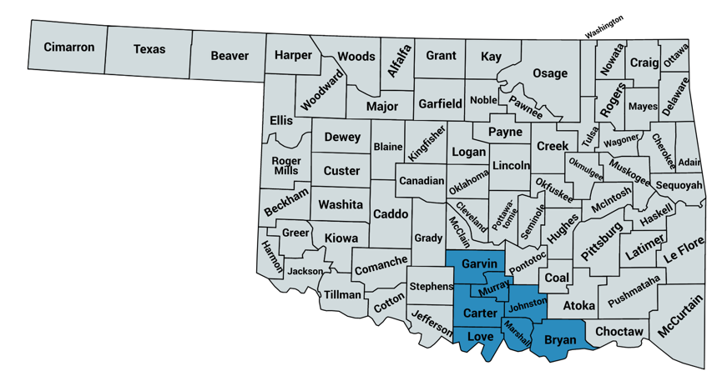
SCOPE-OK Service Area
Targeting 7 counties in south central/ I-35 corridor region
Bryan
Carter
Garvin
Johnston
Love
Marshall
Murray

Slide 5
SCOPE-OK Can Help!
Training
Our certified trainers can train anyone on naloxone use or stigma of substance use disorders.
Community Collaboration
We can collaborate with your organization to work on your goals related to prevention, treatment, and recovery.
Technical Assistance
Let us assist you in implementing or optimizing your technology to create better care coordination opportunities.
Education Events
We host a variety of events focused on a variety of topics including sensitivity of results, prescribing guidelines, telehealth, value-based care models, and more .
Visit our website!
OFMQ.com/scope-ok

Slide 6
SCOPE-OK Can Help!
EHR Care Coordination
Treatment and Referrals
Workforce Enhancement
Staffing/Loan Repayment
Billing/Coding Optimization
Visit our website!
OFMQ.com/scope-ok

Slide 7
Lori Lovett
Lori Lovett received her BS in Biology from the University of Mary Washington. She worked as a research technician in Arthritis & Immunology at OMRF before becoming an educator. During her 25+ year career, she taught a variety of science courses at a local high school and built one of the first biomedical science programs in the state of Oklahoma. She taught this program for ten years. She was a curriculum contributor to a national biomedical science curricula provider and a Master Teacher. She was also the co-owner of a company that provided management services related to vaccine field safety studies and quality assurance for a major pharmaceutical company.
Lori has worked for the OSDH since 2019 as a TSET grantee, and in 2020 as a Community Drug Overdose Prevention Project Coordinator.

Slide 8
Drug Overdose Prevention & Harm Reduction
Injury Prevention Service
Notes:
Good morning, this is going to be a general overview of harm reduction just to open up any discussions you might want to have. The official Train the Trainer Harm Reduction PPT will come in a few weeks and that will be the official ppt for you guys.
I know many of you attended the OSDH Harm Reduction Training on Tuesday so some of this might be redundant, and I apologize for that. We will try to keep it pretty laid back so feel free to ask questions or engage in discussion along the way or at the end. Some slides are the same as the general DO ppt, but it never hurts to discuss them again.
I want to bring up something super important that we will continue discussing with the harm reduction train the trainer, but we can certainly start the conversation now.
When we are discussing or providing education in the community make sure you are extremely careful about your language around harm reduction. According to legislation, all services should be summed up and referred to as harm reduction programming and we need avoid terms such as syringe or needle altogether.
It is super important avoid those terms even if equipment exchange is what a particular harm reduction program is centered around.
We want to be respectful of this current harm reduction legislation because it does sunset in 5 years, and when that happens we really need legislation to pass again and hopefully further expand services. Fingers crossed, if we really work on reducing stigma around drug use and individuals with substance use disorder, in 5 years the community will feel more humility and receptive to particular verbiage and program descriptions.
Feel free to discuss or ask questions this or anything else

Slide 9
Scope of the Problem
Overdose Related Deaths in Oklahoma

Slide 10
Age-adjusted Drug Overdose Death Rates (All Intents), Oklahoma and United States, 2000-2020
Nearly 90% of drug overdose deaths in Oklahoma were unintentional
Notes:
Explain graph
Prior to 2016, OK rates were much higher than the national rates (national rate increases largely due to increases in illicit fentanyl)
Reduction in OK DO rates from 2016-2019 with an increase happening 2019-2020 of 16% increase compared to the US at a 31% increase.
2009, OK had the 2nd highest DO rate ; 2019 OK had the 33rd highest OK DO rate
2000, 237 DO deaths
2016, 813
2017, 775
2018, 716
2019, 645
2020, 762 (WONDER for 2020 and WISQARS for above – WIQARS doesn’t have 2020 data yet)
Majority of DO deaths in OK are unintentional (Due to differences in data collection among states, all intents are included for national-level comparison)
Explain unintentional/accidental
Important in the context of prevention/intervention

Slide 11
Unintentional Drug Overdose Deaths by Type of Drug, Oklahoma, 2011-2020
Notes:
This slide is an overview of drug overdose death by type of drug in OK from 2011-2020
Keep in mind, the majority of overdose deaths in Oklahoma are unintentional or accidental
From 2019 to 2020 alone, the number of drug overdose deaths increased by 29%
And The number of methamphetamine overdose deaths increased by 38%
Also keep in mind that the majority of DO deaths in OK involve one substance
The green line on this slide represents opioid use, which includes both prescription and illicit
Prescription opiates: those prescribed by providers to treat moderate to severe pain (oxycodone, hydrocodone, morphine, methadone)
Heroin is an illegal opioid
Fentanyl is a synthetic opioid often illegally made and distributed
Methamphetamine use – increased by 365% from 2011-2020 and is the most common type of substance involved in OD deaths in Oklahoma

Slide 12
Unintentional Opioid Overdose Deaths by Drug, Oklahoma, 2011-2020
Notes:
This slide represents is a breakdown of opioid specific deaths
Historically, most opioid-related deaths in OK were from prescribed medication, but that has recently changed with the majority of deaths occurring from the illicit opioids, such as fentanyl and heroin, which is also why we want to start discussing opioids more comprehensively in the community
Over the past 10 years unintentional overdose deaths involving prescription opioids have decreased pretty dramatically (dashed lines)
However, heroin (solid brown line) and fentanyl (solid blue line) have increased
Fentanyl deaths more than doubled from 2019-2020 increasing
Part of that is because illicit fentanyl easy to manufacture and has a high potency which makes it highly profitability

Slide 13
Unintentional Prescription Opioid-related Overdose Death Rates¹ and Opioid Sales per Person², Oklahoma, 2000-2019

Slide 14
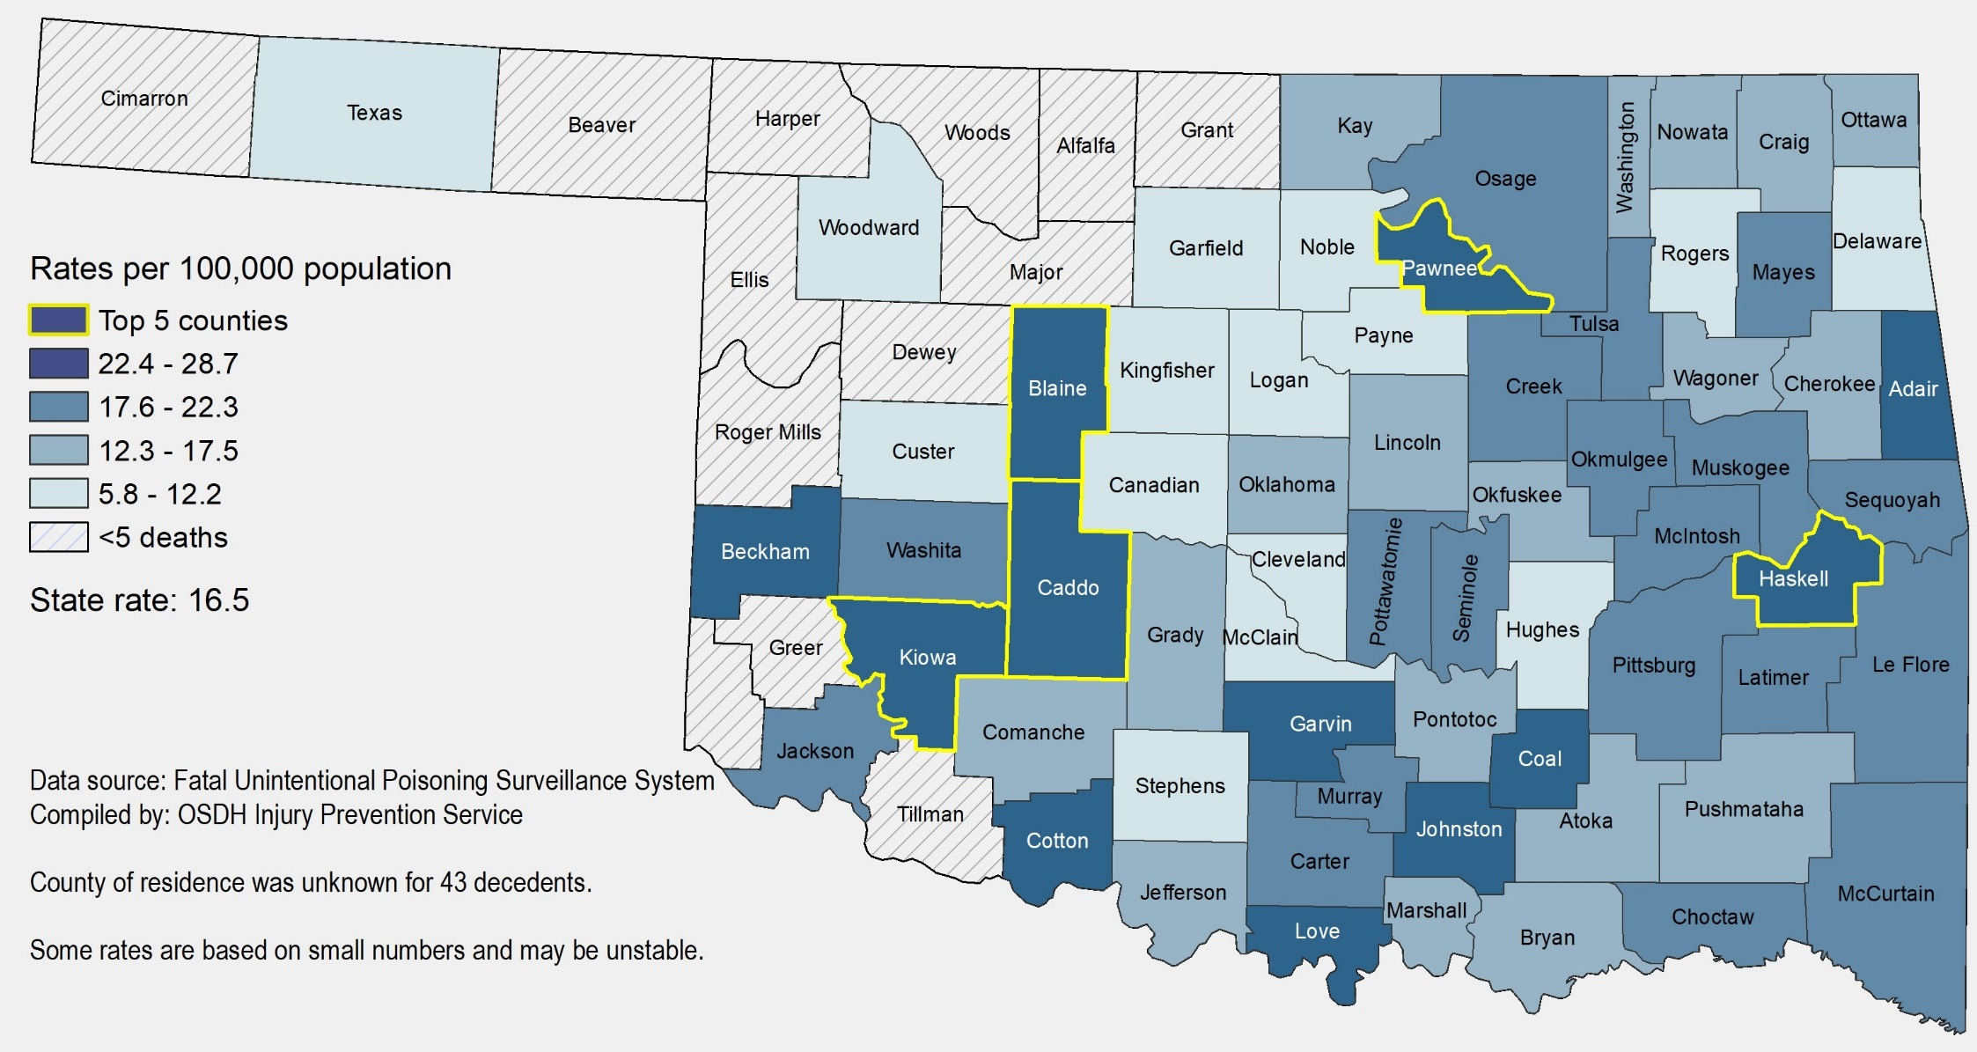
Unintentional Drug Overdose Death Rates by County of Residence, Oklahoma, 2016-2020

Slide 15
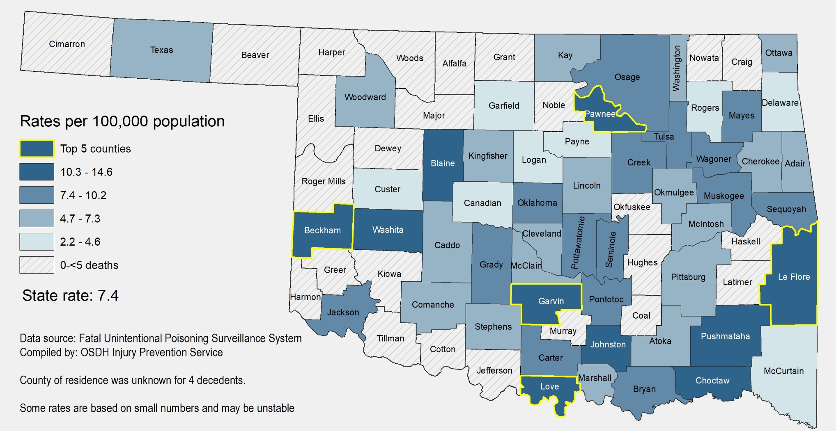
Unintentional Opioid Overdose Death Rates by County of Residence, Oklahoma, 2016-2020

Slide 16
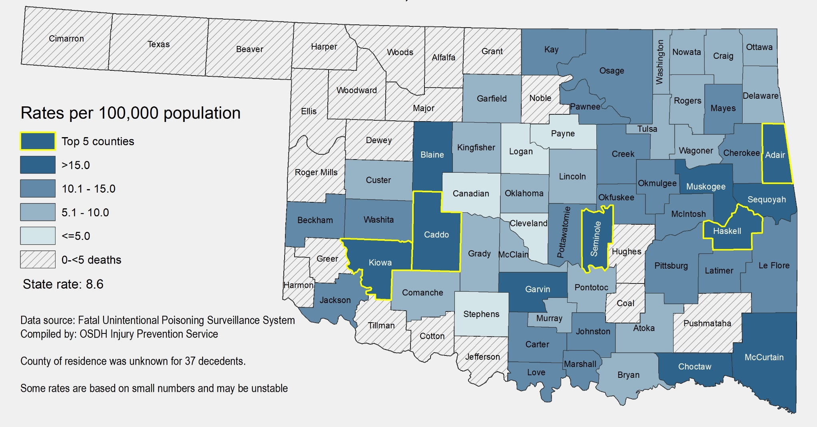
Unintentional Methamphetamine Overdose Death Rates by County of Residence, Oklahoma, 2016-2020

Slide 17
Notes:
Based on current data, For every 7 DO related ED visits, there are ~5 inpatient hospitalizations, and 1 death.

Slide 18
Overdose Distribution by Age Group, Gender, and Overdose Severity, Oklahoma, 2020*
Deaths
Male (66%)
Age groups: 45-54, 55-64 (both 24%), 35-44 (21%)
Inpatient Hospitalizations (nonfatal)
Female (61%)
Age groups: 15-24 (19%); 25-34, 35-44, 55-64 (each 15%)
Emergency Department (nonfatal)
Female (57%)
Age groups: 15-24 (25%), <11 and 25-34 (both 16%)

Slide 19
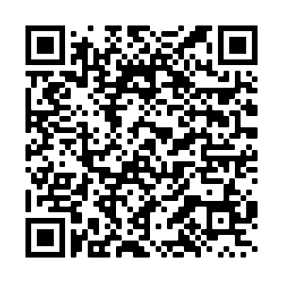
What does your county look like?
County Fact Sheet has been included
Go to https://oklahoma.gov/health/health-education/injury-prevention-service/drug-overdose/county-fact-sheets.html
Easiest way to find is to Google Injury Prevention Service Oklahoma and select the choice that has the color wheel.
OR…..

Slide 20
Substance Use Disorder
Understanding Drug Use

Slide 21
Dependence versus Addiction/Substance Use Disorder (SUD)
What is substance dependence?
Physical need
Increased tolerance
Ceasing causes withdrawal
Physical dependence can be independent of addiction
What is drug addiction (SUD)?
Addiction is defined as a chronic, relapsing brain disease that is characterized by compulsive drug seeking and use, despite harmful consequence.
Drugs change the brain
A lot like other diseases
Not a moral failing or lack of willpower
Oklahoma State Department of Health
Notes:
All addictive substances activate the reward center in the brain raising the levels of dopamine
Understanding the difference between addiction and dependence and be confusing.
When people use the term “dependence,” they are usually referring to a physical dependence on a substance. Dependence is characterized by the symptoms of tolerance and withdrawal. Although it is possible to have a physical dependence without being addicted.
Addiction—or compulsive drug use despite harmful consequences, is often characterized by an inability to stop using a substance, failure to meet work, social, or family obligations, and, sometimes (depending on the drug), includes tolerance and withdrawal.
Tolerance is when the body adapts to the substance and requires more to achieve a specific effect.
Withdrawal consists of drug-specific physical or mental symptoms if the drug is stopped suddenly.
Physical dependence can happen with the chronic use of many substances, including prescription medications, even if taken as instructed. So, physical dependence in and of itself does not constitute addiction, but it often accompanies addiction.
Addiction doesn’t affect every person who is repeatedly exposed to an addictive substance
As with any other disease, vulnerability to substance use disorder differs from person to person
Remember you can build a tolerance or dependence to many types of substances including prescription and over the counter medications such as sleep medicines, laxatives, antidepressants, and even caffeine

Slide 22
Understanding Drug Use
Why do people take drugs?
To feel good
To feel better
To do better
Escapism
Coping with stressful situations or past traumas
Curiosity and “because others are doing it”
Why people “don’t just stop” using drugs
May help manage physical and emotional pain
May be physically dependent (avoiding withdrawal)
May help with other co-occurring situations (homelessness, job loss)
May not have access to medical and support services
NHRC. (2020). Guide to developing and managing syringe access programs: Harm reduction basics. https://harmreduction.org/issues/syringe-access/guide-to-managing-programs/basics/
Notes:
Why do people use drugs?
Drug use is a complex, multi-faceted phenomenon that encompasses a range of behaviors. Likewise, PWUD are complex, multifaceted individuals who are more than their behaviors and may have different reasons for why they use drugs. MAYBE:
They are using methamphetamine at night because they are homeless and trying to stay awake to avoid being robbed or attacked
Perhaps they take benzodiazepines to deal with extreme anxiety (and they live in an isolated area without access to transportation or mental health services)
Or maybe they use heroin because of a work-related injury and they were cut off from health insurance for prescription pain medications, heroin is more accessible, manages the pain, and is cheaper
In order to work effectively with PWUD, it’s important to avoid making assumptions about why someone may use drugs or what it means about them – it just means they’re a person who is using drugs and has needs like everyone else.
Why people “don’t just stop” using drugs
It May help people feel good or feel better in the moment
It could help manage physical and emotional pain
They might be more accessible or cheaper compared with prescribed drugs
They May help some individuals feel more social or connected
Drug use may help co-occurring situations feel more manageable – including homelessness, lack of employment, lack of social support, and unmet mental health needs
The individual may also be physically dependent and experience withdrawal without continued use
Or they May not have access to options – including support services | to stop using drugs (such as treatment)
Some people may not be interested in abstaining from drugs

Slide 23
What is stigma?
Stigma consists of labeling someone with an associated stereotype that elicits a negative response.
Common stigma towards patients with SUD include:
Dangerous
Unpredictable
Incapable of managing treatment
Caused their condition
Can stop at will
NIDA (2021). Words matter: Terms to use and avoid when talking about addiction. https://www.drugabuse.gov/nidamed-medical-health-professionals/health-professions-education/words-matter-terms-to-use-avoid-when-talking-about-addiction
Notes:
Stigma is a discrimination against an identifiable group of people, a place, or a nation. Stigma about people with SUD might include stereotyping thoughts like they are dangerous, incapable of managing treatment, or at fault for their condition.
For people with an SUD, stigma may stem from an outdated belief that addiction is a moral failing, instead of what we know— it’s a chronic, treatable disease from which patients can recover and continue to lead healthy lives.
Many mistakenly think that people who use drugs
Lack morals and willpower
That they’re lazy and deviant
They are often labeled as criminals
Seen as dangerous and unpredictable
And incapable of managing their treatment

Slide 24
How does Stigma affect People with SUD?
Stigma is a perceived negative attribute that causes someone to devalue or think less of the whole person.
Keeps people separated
Negatively impacts their interactions with providers
Decreases their willingness to seek treatment or services
Creates societal layers of self shame
Leads others to social distance from them resulting in isolation
Isolation and Loss of Support = Loss of Hope
Trauma
Loss of Support
Loss of Hope
Substance Use
Isolation
Stigma
Oklahoma State Department of Health
NHRC. (2021). Respect to connect: Undoing stigma. https://harmreduction.org/issues/harm-reduction-basics/undoing-stigma-facts/
Notes:
Drug-related stigma
can be compounded by other stigmas and prejudices related to race/ethnicity, sexual orientation, gender, class, HIV status, incarceration history, and poverty
These stigmas, along with inequality and social determinants of health can affect the persons capacity for effectively dealing with drug-related harm.
Feeling stigmatized can reduce the willingness of individuals with SUD to seek treatment or services
In addition stigma can lead others to feel pity, fear, anger, and a desire to socially distance from people with an SUD, leading to a continued loss of support and loss of hope
“loose all support, loose all hope”

Slide 25
Harm Reduction 101
Concepts of Harm Reduction

Slide 26
What is Harm Reduction?
The purpose of harm reduction is to make substance use safer, reduce harms associated with substance misuse, and decrease risk of overdose death.
Notes:
Although there is no universally accepted definition of harm reduction, most individuals agree that Harm Reduction is a set of practical, public health strategies designed to reduce the negative consequences of drug use and promote healthy individual lifestyles and communities.
Harm reduction is a person-centered concept that accepts two fundamental truisms
•Illicit and licit substance use is a reality, present throughout history. AND
•There are very real and significant dangers directly associated with substance use as we know it in today's modern world

Slide 27
Harm Reduction:
Acknowledges that many people will continue substance misuse and engage in other dangerous behaviors despite prevention efforts.
Accepts that many people are unwilling or unable to seek treatment.
Recognizes that while some people who use substances may not necessarily require treatment, it is helpful for them to be aware of resources that can help minimize harm from their substance use.
Notes:
The goals of harm reduction is to improve the health and well-being of individuals, their partners, friends, families, and communities
Harm reduction refers to policies, programs, and practices that aim to minimize adverse health, social and legal impacts of drug use. It is grounded in human rights and social justice and focuses on positive change and working with people without judgment, coercion, discrimination, or requiring that they stop using drugs as a precondition of support.
It also encompasses a range of health and social services and practices that apply to illicit and licit drugs. Globally, (non specific to OK) Some of these include, drug consumption rooms, equipment exchange programs, non-abstinence-based housing and employment, drug checking, overdose prevention and reversal, psychosocial support, and education on safer drug use.
These type of preventative approaches are proven cost-effective, evidence-based, and positively impact individual and community health.

Slide 28
Foundational Principles of Harm Reduction
Accepts that licit and illicit substance use is a reality, and minimizing the harmful effects is more beneficial than simply ignoring or condemning them.
Understands substance use as a complex, multi-faceted phenomenon that encompasses a continuum of behaviors (severe-use to abstinence) and some ways of using drugs are safer than others.
Establishes quality of individual and community life and well-being — not necessarily cessation of substance use — as the criteria for successful interventions and policies.
Oklahoma State Department of Health
Notes:
Harm reduction is not a specific ridged protocol. It should be adapted to reflect the specific needs of both the individual and the community.
There’s no one single way to “do harm reduction”.
Harm reduction should be based on the individual’s starting point and their readiness to change a risk behavior- basically we want to “Meet them where they’re at” and apply strategies aimed at reducing harm as much as possible, with the individual empowered to make those decisions
In addition it establishes quality of well-being — not necessarily cessation of substance use — as the criteria for success.

Slide 29
Foundational Principles of Harm Reduction
Necessitates non-judgmental, non-coercive provision of services and resources to people who use drugs and the communities in which they live in order to assist them in reducing harm.
Seeks to empower people who use drugs in strategies that meet them where they are. Individuals who engage in substance misuse are the primary agents of reducing the harms of their drug use.
Recognizes the realities of how poverty, class, racism, social isolation, past trauma, sex-based discrimination, and other social inequalities affect people’s vulnerability and capacity to deal with substance-related harm.
NHRC. (n.d.). Principles of harm reduction. https://harmreduction.org/about-us/principles-of-harm-reduction/
CDC (2019). Syringe services programs. https://www.cdc.gov/ssp/syringe-services-programs-faq.html
Notes:
Harm reduction is rooted in a commitment to addressing discrimination and ensuring that nobody is excluded from the health and social services they may need because of their substance use, their race, their gender, gender identity, sexual orientation, and their choice of work, or economic status.
In addition, people should be able to access services without having to overcome unnecessary barriers, including, discriminatory regulations.
Another strategy of inclusiveness is the meaningful involvement of people who use drugs in designing, implementing, and evaluating the harm reduction programs and policies that serve them.

Slide 30
Why Harm Reduction Works

Slide 31
Why Harm Reduction Services are Needed
The U.S. is experiencing the most significant substance use and overdose epidemic it has ever faced, exacerbated by the COVID-19 pandemic, and driven by the proliferation of highly potent synthetic opioids containing primarily fentanyl and other analogues.
Harm reduction services save lives by being available and accessible to people, and emphasizing the need for humility and compassion toward people who use drugs.
Harm reduction plays a significant role in preventing drug-related deaths and offering access to healthcare, social services, and treatment.
Harm reduction services decrease overdose fatalities, acute life-threatening infections related to unsterile drug injection, and chronic diseases such as HIV and hepatitis.
SAMHSA (2022). Harm reduction. https://www.samhsa.gov/hind-help/harm-reduction
Notes:
Why do we need these harm reduction services?
The United States continues to experience a significant substance use and overdose epidemic which seems to have worsened in the face of COVID and new more deadly substances such as fentanyl
Harm reduction services save lives by being available and accessible to people and emphasizing the need for humility and compassion toward individuals who use drugs. Harm reduction plays a significant role in preventing drug-related deaths and offering access to healthcare, social services, and treatment.
This reduces overdose fatalities, acute life-threatening infections related to unsterile drug injection, and chronic diseases such as HIV/HCV.

Slide 32
Harm Reduction Prevention, Treatment, and Recovery
Harm Reduction Services Can:
Connect individuals to overdose education, counseling, and referral to treatment for infectious diseases and substance use disorders.
Distribute opioid overdose reversal medications (e.g., naloxone) to individuals at risk of overdose, or to those who might respond to an overdose.
Lessen harms associated with drug use and related behaviors that increase the risk of infectious diseases, including HIV, viral hepatitis, and bacterial and fungal infections.
Reduce infectious disease transmission among people who use drugs, including those who inject drugs, by equipping them with accurate information and facilitating referral to resources.
Reduce overdose deaths, promote linkages to care, and facilitate co-location of services as part of a comprehensive, integrated approach.
SAMHSA (2022). Harm reduction. https://www.samhsa.gov/hind-help/harm-reduction
Notes:
Harm reduction is part of the overall continuum of care. It encompasses approaches proven to prevent death, injury, and disease. It is an effective approach to addressing the public health epidemic involving substance use as well as infectious disease and other harms associated with drug use.
It can connect individual to overdose prevention information such as education, counseling and referral to treatment for SUD or infectious diseases
Also it provides an opportunity to distribute Narcan or Naloxone to individual at risk or who might witness an overdose
Harm reduction offers education on decreasing the behavioral risk of injection drug use to prevent HIV, viral hepatitis, and other infectious disease
Can also:
Reduce stigma associated with substance use and co-occurring disorders
Promote a philosophy of hope and healing by utilizing those with lived experience in the management of harm reduction services, and connecting those who have expressed interest, to treatment, peer support workers and other recovery support services.

Slide 33
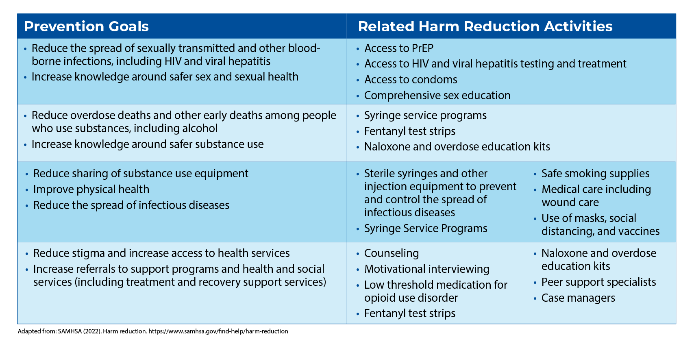
Harm Reduction Activities and Intended Outcomes
Notes:
Incorporating harm reduction activities can reduce many negative effects on health and social wellbeing due to use of alcohol, other drugs, and related behaviors.
It can optimizes sexual health and Reduce the spread of sexually transmitted and other blood-borne infections by providing access to PrEP and PEP (pre- and post exposure prophylaxis) to prevent HIV also many programs also offer access to condoms or other contraceptive options
Harm reduction activities Reduce overdose risk among individuals who use substances by offering fentanyl testing, Narcan, new sterile injection equipment
And as we spoke about before reduces stigma and breaks access barriers to both health and social services

Slide 34
Harm Reduction Prevents Drug Overdose

Slide 35
Notes:
This is an overview of how prevention and harm reduction intersect.
As noted they meet in the middle where we start to focus on reducing harm through early detection and education once problematic use has already begun
And harm reduction extends all the way through the green when the focus becomes reducing harms that could result in serious deterioration or death.

Slide 36
Notes:
This diagram shows best practices for overdose prevention.
The green represents primary prevention strategies, using upstream approaches to prevent people from initiating drug use by reducing vulnerability
The middle is secondary prevention strategies focusing on reduction of the risk of overdose such as education, screening, support and treatment
And the top prevention strategies is a lot of our overview today which includes equipment exchange, naloxone programs, good Samaritan, and fentanyl testing

Slide 37
Harm Reduction Programs
Although the services they provide may vary, harm reduction programs are community-based programs that provide access to sterile equipment, facilitate safe disposal of used equipment, and provide and link to other important services and programs such as:
Referral to substance use treatment programs
Screening, care, and treatment for viral hepatitis and HIV
HIV pre- and post-exposure prophylaxis
Screening for sexually transmitted infections
Abscess and wound care
Education about overdose prevention and safer drug use practices
Vaccinations, including those for hepatitis A and hepatitis B
Referral to social, mental health, and other medical services
Naloxone distribution and education
Access to drug checking/fentanyl testing
Notes:
Although the services they provide may vary, Harm Reduction Programs are community-based programs that provide access to sterile equipment, they facilitate safe disposal of used supplies, and provide and link individuals to other important services and programs such as:
Substance use treatment
Screening and treatment for HIV and viral hepatitis
HIV Testing and Prophylaxis Medication
Screening and testing for sexually transmitted infections
Abscess and wound care
Education on overdose prevention and safe injection practices
Vaccinations
Narcan distribution and education
Access to drug checking
And linkages to social, mental health and medical services (in many communities this includes linkages to non abstinence housing and employments opportunities)

Slide 38
Notes:
Nonsterile injections can lead to transmission of HIV, viral hepatitis, bacterial, and fungal infections and other complications.
By providing access to sterile injection equipment, Harm Reduction Programs help people prevent transmitting bloodborne and other infections when they inject drugs.
In addition to being at risk for HIV, viral hepatitis, and other blood-borne and sexually transmitted infections, people who inject drugs can get other serious, life-threatening, and costly health problems, such as infections of the heart valves (endocarditis), serious skin infections, and deep tissue abscesses.
Access to sterile supplies can help prevent these infections, and health care provided within Harm Reduction Programs can catch these problems early and provide easy-to-access treatment to a population that may be reluctant to go to a hospital or seek other medical care.

Slide 39
Do Harm Reduction Programs Reduce Drug Overdose?
Individuals who inject drugs and use harm reduction services are more likely to enter treatment for substance use and reduce or stop injecting.
New users of harm reduction services are five times more likely to enter drug treatment than those who don’t use a program.
Harm reduction programming play a key role in preventing overdose deaths by training people who inject drugs to prevent, rapidly recognize, and reverse opioid overdoses.
CDC. (2019). Syringe services programs (SSPs). https://www.cdc.gov/ssp/syringe-services-programs-faq.html
Notes:
Do harm reduction programs reduce overdose?
Research indicates utilizing HR services decrease risk of overdose.
In fact individuals who inject substances and utilize harm reduction services are more likely to enter treatment, and reduce substance use
They are also three times more likely to reduce or stop illicit substance injection than individuals who don’t use harm reduction services
In addition harm reduction programming play a key role in providing education to prevent overdose by educating clients and community members on identifying an overdose and administering opioid reversal agents such as Narcan

Slide 40
Good Samaritan Drug Overdose Laws
Good Samaritan drug overdose laws provide immunity from prosecution for drug possession when individuals who are experiencing or witnessing an overdose seek emergency services
Good Samaritan drug overdose laws are a suggested strategy to reduce drug overdose deaths.
Available evidence suggests that fear of arrest can lead bystanders to delay or forgo calling 911, increasing risk of overdose death.
Many witnesses to a drug overdose will try other, often dangerous, methods to revive the overdose victim and delay calling 911.
The majority of overdose deaths occur within 3 hours of taking the substance, and most of these deaths occur in the presence of others. This situation gives a significant amount of time for witnesses to the overdose to intervene and call for medical assistance.
County Health Rankings & Roadmaps (2021). Good Samaritan drug overdose laws. https://www.countyhealthrankings.org/take-action-to-improve-health/what-works-for-health/strategies/good-samaritan-drug-overdose-laws
Notes:
Good Samaritan drug overdose laws provide immunity from prosecution, for drug possession, when individuals who are experiencing or witnessing an overdose seek emergency services
-Many bystanders delay calling 911 increasing risk of overdose or what I’ve seen often people are just left at the door or in the lobby and sometimes in the parking lot of the ER
Good Samaritan laws vary by state; some states provide expansive protection whiles others may offer less sizable security.
-40 states and the District of Columbia have enacted some form of a Good Samaritan or 911 drug immunity law
-Research suggest that individuals who use substances and learn about Good Samaritan laws, are more likely to call 911 during an overdose
-law enforcement officers in states that have adopted Good Samaritan laws report that these laws have improved citizens’ image of law enforcement

Slide 41
Oklahoma’s Good Samaritan Law
A peace officer shall not take a person into custody based solely on the commission of an offense involving a controlled substance if:
The individual reasonably appeared to be in need due to the use of a controlled dangerous substance.
The person:
provided their full name and any other relevant information requested,
remained at the scene with the individual who reasonably appeared to be in need, and
cooperated with emergency medical personnel and peace officers.
Good Samaritans and overdose survivors can call 211 to access 24-hour assistance and linkage to local resources.
Notes:
This slide represents the verbiage seen on Oklahoma’s Good Samaritan Law
A peace officer shall not take a person into custody based solely on the commission of an offense involving a controlled substance if:
The individual appears to be in need, due to the use of a controlled dangerous substance
And
The person
Provides their full name and relevant information
Remains at the scene with the individual in need
And if fully cooperative with EMS and officers

Slide 42
Fentanyl Overview
Fentanyl is a synthetic opioid 50 times more potent than heroin. It is more condensed, more potent opioid, which means consuming the same amount of heroin and fentanyl may have different impacts on the body based on an individual’s tolerance.
Most recent cases of fentanyl-related harm are linked to illicitly made fentanyl
It is often mixed with other drugs such as, heroin, methamphetamines, other opioids, marijuana, and/or cocaine
Fentanyl is often utilized because it is cheap to manufacture, and a little goes a long way
The risk of overdose exists when any fentanyl is present given its potency and lethality
Many individuals consume fentanyl without their knowledge, while others are intentionally using fentanyl because of its potency
Fentanyl and fentanyl analogues (some stronger, some weaker) are not “naloxone resistant.” They are opioids and will respond to naloxone in the event of an overdose
Touching fentanyl is unlikely to cause opioid toxicity to first responders
Notes:
Fentanyl is a synthetic opioid 50 times stronger than heroin which means that consuming the same amount of fentanyl and heroin may impact the body differently depending on tolerance
Although fentanyl is a prescribed pain medication, mostly given in healthcare settings, the majority of fentanyl-related harm are linked to illicitly made fentanyl
It is commonly mixed with other drugs including heroin, meth, marijuana and cocaine because it is cheap to manufacture, but that means that it is common that individuals may not realize they have fentanyl in their supply increasing risk of overdoes
Please keep in mind that although fentanyl and its analogues are very potent opioids, it is not resistant to naloxone, Naloxone can and will work for fentanyl overdose although it may take more than one does for the individual to respond.
The risk of fentanyl overdose or exposure to emergency responders is extremely low.
To date, there have not been reports of emergency responders developing signs or symptoms consistent with opioid toxicity from incidental contact with opioids.

Slide 43
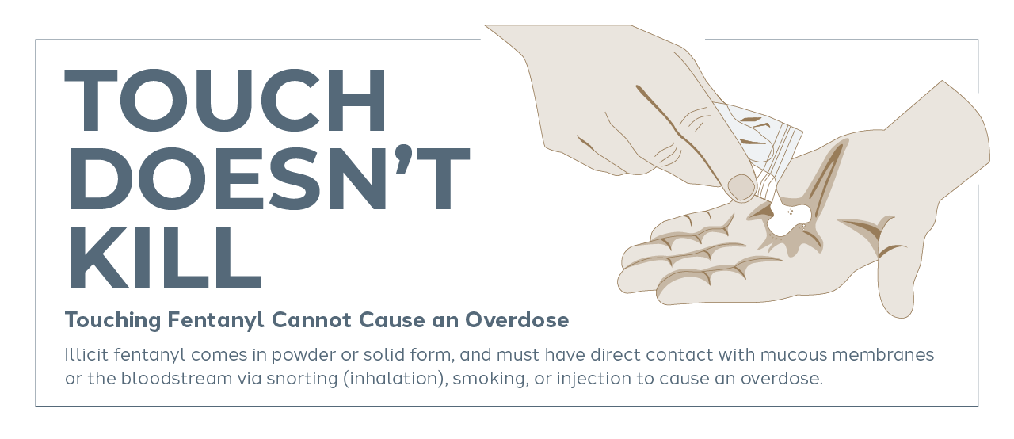
Touch Doesn’t Kill
Notes:
These Stories about unintentional overdoses to first responders create hysteria, which creates the potential for delays in treatment of people who are sick from drugs. In the event of an overdose, every second counts. We need our bystanders, family, friends, and first responders to be empowered and equipped to act in case they witness an overdose. Hopefully through education, we can change this harmful narrative and encourage more people to act in time of crisis.
Fentanyl powder is essentially not absorbed through skin, and would take massive amounts over long time to cause an overdose. Even in extremely potent fentanyl analogs
“The fentanyl in the illicit drug supply comes in powder or solid form, and must have direct contact with mucous membranes or the bloodstream via snorting (inhalation), smoking, or injection to take effect.

Slide 44
Official Position Statements
“Skin contact is also a potential exposure route, but is not likely to lead to overdose unless exposures are to liquid or to a powder over an extended period of time. Brief skin contact with illicit fentanyl is not expected to lead to toxic effects if any visible contamination is promptly removed.”
– CDC on Fentanyl Exposure Prevention
“Fentanyl and its analogs are potent opioid receptor agonists, but the risk of clinically significant exposure to emergency responders is extremely low. To date, we have not seen reports of emergency responders developing signs or symptoms consistent with opioid toxicity from incidental contact with opioids. Incidental dermal absorption is unlikely to cause opioid toxicity..”
– American College of Medical Toxicology (ACMT) and American Academy of Clinical Toxicology (AACT) Official Position Statement
Notes:
Several position statements have been released stating that overdose risk by first responders is not likely and to date there have not been any reports of emergency responders developing signs of overdose from contact with opioids

Slide 45
Myths About Fentanyl

Slide 46
Fentanyl Test Strips (FTS)
Fentanyl test strips can be used to detect fentanyl and, in some cases, fentanyl analogues, which are commonly found in the drug supply — alone and mixed with other illicit substances such as heroin, cocaine, and methamphetamine.
A simple evidence-based method of averting drug overdose
FTS are small strips of paper similar in appearance to urine testing strips
The process of obtaining FTS brings individuals in contact with other harm reduction support and community services (linking the person to services and closing the loop of care)
Individuals are provided with valuable information that can best support that persons unique situation
FTS also support the dignity and well-being of people who use drugs, enabling them to make educated decisions about their safety.
Notes:
Fentanyl Test Strips, is a type of “Drug checking” proven to reducing overdose risk
-Individuals using a substance, may have no idea that a powerful synthetic opioid could be present, and FTS are a simple, evidence-based method of testing the substance and averting drug overdose
-Fentanyl test strips not only have the potential to reduce overdoses, but the process of obtaining them can bring individuals with substance use disorders in contact with a community organization or other harm reduction support for the first time and can lead to reduced risk for substance-related harms and improved health outcomes.
-By testing a drug batch with a single fentanyl test strip, the individual is provided valuable information that can best support their unique situation: The user can choose to use a different batch, use less of the current batch, use in the presence of others, or make sure naloxone is on hand.
-Although the strips do not provide information on the exact amount of fentanyl present, testing can provide enough time, space, and information for an individual to contemplate their options. This alone can support a greater sense of empowerment over health, prompting safer behaviors and practices

Slide 47
Naloxone (Narcan)
Naloxone is a medication that can quickly and safely reverse an opioid related overdose.
Naloxone is a non-addictive prescription medication
No harmful side effects
It only works if a person has opioids in their system; it has no effect if opioids are absent
Naloxone has no potential for abuse
Naloxone may be injected in a muscle, vein, or under the skin, or sprayed into the nose
It wears off in 20-90 minutes
NHRC. (2020). Opioid overdose basics: Understanding naloxone. https://harmreduction.org/issues/overdose-prevention/overview/overdose-basics/understanding-naloxone/
Oklahoma State Department of Health
Notes:
Naloxone
Naloxone (also known by the brand name Narcan) is a medication called an opioid antagonist, which means it is able to knock the opioids off the brain’s opioid receptors allowing the person to breath again, and quickly and safely reverses an opioid overdose
Naloxone only works for opioid overdoses. If the overdose is a result of using both alcohol and opioids, administering naloxone might help by addressing the opioid part of the overdose.
Naloxone is a non-addictive prescription medication with no harmful side effects
It only works if a person has opioids in their system; it has no effect if opioids are absent
There is no potential for abuse
And can be injected in a muscle, vein, under the skin, or sprayed into the nose. And lasts 20-90 minutes

Slide 48
Overdose Response and Naloxone Administration
911 should be called, or person taken to the hospital
If there is no reaction a second dose can be given without harm
Check breathing and follow 911 dispatcher instructions (may need rescue breathing or chest compressions)
Stay with the person until help arrives, naloxone does wear off
If the person refuses EMS help, make sure someone stays with them for several hours
Oklahoma State Department of Health
Notes:
Overdose Response and Naloxone Administration
If there is suspicion of overdose, call 911 immediately and administer Naloxone
A second dose can be given if the person continues to be non responsive
Naloxone only lasts between 20-90 minutes and often the effects of the opioids last much longer, so is possible that after the naloxone wears off the overdose could recur.
If the person refuses aftercare from EMS, it is important that someone stays with them and waits out the risk period in case another dose is needed.
After giving someone naloxone, they often wake up feeling symptoms of withdrawal and may want to use again right away. It is very important that a person does not use again immediately, to avoid a second overdose, or re-sedation.
Remember that naloxone administration may be repeated without harm if the person goes out again

Slide 49
Oklahoma Emergency Medical Personnel Naloxone Project
Training and intranasal naloxone available to ambulance services, fire departments, and volunteer fire departments
Online training (Oklahoma.gov/health/overdose)
Once all agency staff have competed the training, submit the appropriate memorandum of agreement to IPS to receive free naloxone kits
Training and free naloxone kits available to law enforcement and the general public through the ODMHSAS. For more information, contact Megan Wurzer at megan.wurzer@odmhsas.org.
Notes:
OSDH supplies ambulance services, fire departments, and volunteer fire departments Naloxone through our Naloxone Project. All you guys have to do is refer any EMS personnel to me or Jeannie and we will make sure their questions are answered and they receive Naloxone.
So you guys don’t have to do anything more than that,
but to give you an overview of what happens on our end:
When an agency wants to receive Narcan, we have all the all agency staff watch an online training video, then and they must sign an annual MOA with us.
Once they have all staff watch the video and I receive their signed MOA I will place an order with our pharmacy to mail 1 kit (which is 2 doses) for every active agency vehicle.
If they use a dose, they fill out what we call a usage form and once I receive that form I will immediately order them a new dose.
If they have an expired dose or kit all they have to do is contact me and I will send them a replacement kit.
They keep and dispose of the expired kit per their agency protocol for expired medications.

Slide 50
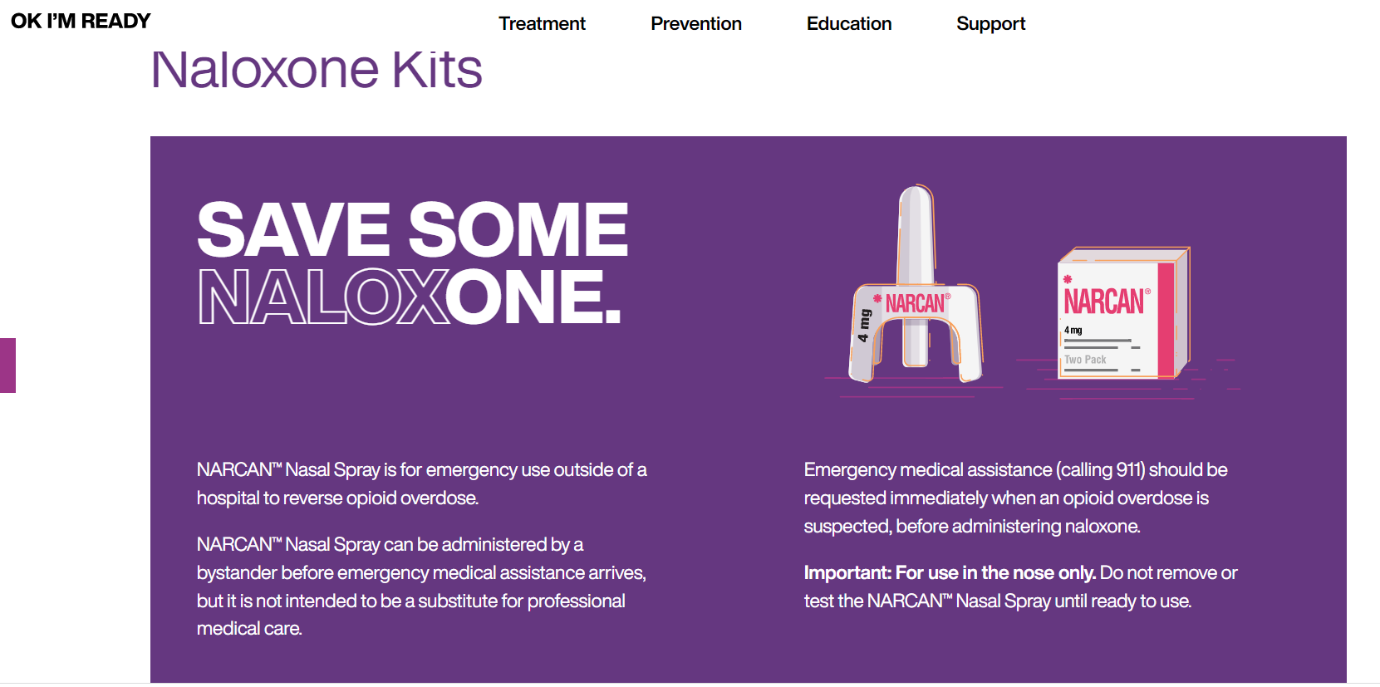

Slide 51
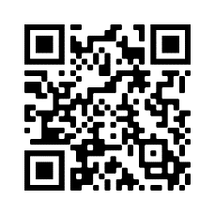
How to obtain training and naloxone:
Individuals can obtain online training and free naloxone kits through the mail. Find information at https://okimready.org/prevention/ or use this QR code:

Slide 52
Signs and Symptoms of a Drug Overdose
Passing out or won’t awaken when aroused
Skin color changes (e.g., bluish if a depressant was used; flush if a stimulant was used)
Abnormal breathing
Loud snoring (gurgling or choking sounds)
Chest pain
Higher or lower than normal body temperature
Fast, slow, or irregular pulse
Vomiting
Irrational behavior or confusion
Signs and symptoms of an overdose may differ depending upon the type of drug consumed.
DO NOT:
Allow the victim to “sleep it off.”
Put the victim in a bath or shower.
Leave the victim alone.
Treat the victim with home remedies – they do not work and often delay potentially life-saving medical treatment
Delay calling 911 to clean up the scene.
Oklahoma State Department of Health
Notes:
Identifying an Overdose
The line between being very high and an overdose is about responsiveness. If someone seems very high and it is getting harder for them to stay awake, it is important that they are not left alone. If the person is still conscious, walk them around, keep them awake, and monitor their breathing.
Overdose signs and symptoms are going to be very specific to the substance especially if distinguishing between a stimulant like meth and a depressant like fentanyl
Overdose signs to look for with an opioid could include:
Unresponsive to stimulation
Fingernails and lips turn blue or purplish black. For lighter skinned people, the skin tone turns bluish purple, for darker skinned people, it turns grayish or ashen.
Breathing is very slow and shallow, erratic, or has stopped
Choking sounds, or a snore-like gurgling noise
Body is very limp
Changes in body temperature
Vomiting
Confusion
Fentanyl overdose can occasionally cause rapid rigidity of the chest so they could feel a very tight chest and shortness of breath
Stimulant overdoses also referred to as overamping, look very different and often feel very different to the individual experiencing the overdose
Taking high doses of a stimulant can raise a person’s body temperature and blood pressure to dangerous levels and make the heart beat irregularly. This can lead to seizures, heart failure, hyperthermia, and death. In my experience deaths from meth are usually cardiac related.
Some signs and symptoms to look for when trying to determine if someone is endanger of taking too much of a stimulant include:
Unable to stay still/often they don’t sleep for long periods of time
Chest pain
Irregular breathing/short of breath
High body temperature
Fast heart rate
Psychosis, confusion and agitation
If you suspect an overdose, DO NOT leave the person alone and DO NOT delay calling 911

Slide 53
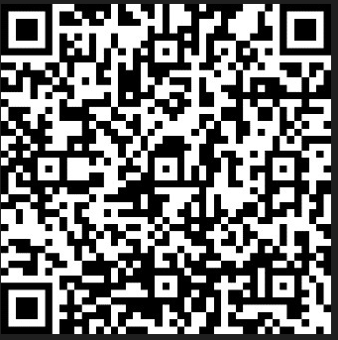
Evaluation:
Please take this short survey!
Scan QR code and complete evaluation or complete paper copy
Date of Event: 09/15/2022
Name of Event: DO Data Update & Harm Reduction
Location of Event: Virtual – SCOPE-OK

Slide 54
Questions?
Lori Lovett
Jefferson CHD - DISTRICT 8
c580-228-6536
Lori.Lovett@health.ok.gov
https://oklahoma.gov/health/health-education/injury-prevention-service.html

Slide 55
Mission of OFMQ
OFMQ is a not-for-profit, consulting company dedicated to advancing healthcare quality. Since 1972, we’ve been a trusted resource through collaborative partnerships and hands-on support to healthcare communities.

Slide 56
Our Organization
In Existence Since 1972
Not-for-profit
Healthcare Resource
Broad Engagement – Hospitals, Clinics, LTC, etc.
Teams of Experts

Slide 57
Our Experience
QIO- 45 Years
Regional Extension Center- 6 Years
Hospital Quality Measures- 16 Years
Analytics for Quality Programs- 23 Years
Value Based Payment Programs-11 years
Case Review- 47 Years
HIPAA Solution- 8 Years
Long-Term Care Quality Improvement- 20 years

Slide 58
Our Difference
Experienced
Diversity of Clients
Hands-on Engagement
Intelligent Staff with Diverse Background
Practical Approaches
Local

Slide 59
Health Information Technology (HIT)

Slide 60
HIT Quality Improvement
Quality Improvement Expertise
Care Transitions and Referral Management
Opioid Misuse and Reduction
Diabetes Prevention Program
Public Health Emergencies
Registry Connections
Reporting Requirements and Guidance
COVID 19 Educational Training and Testing Implementation
Dementia Care
Chronic Disease Management
Food Insecurity
Project ECHO

Slide 61
HIT Quality Improvement
Ambulatory Value-based Care Consulting
Accountable Care Organizations
Merit-based Incentive Payment System
Patient Centered Medical Home
Hospital Reporting
The Joint Commission
Inpatient Quality Reporting
Outpatient Quality Reporting
Promoting Interoperability
Long-Term Care
Quality Improvement

Slide 62
Risk Management & Security Services

Slide 63
Risk Management Overview
Risk Assessment
Security Consulting
Policy and Procedure Development
Risk Management Meetings
Continuous Improvement
Risk Management

Slide 64
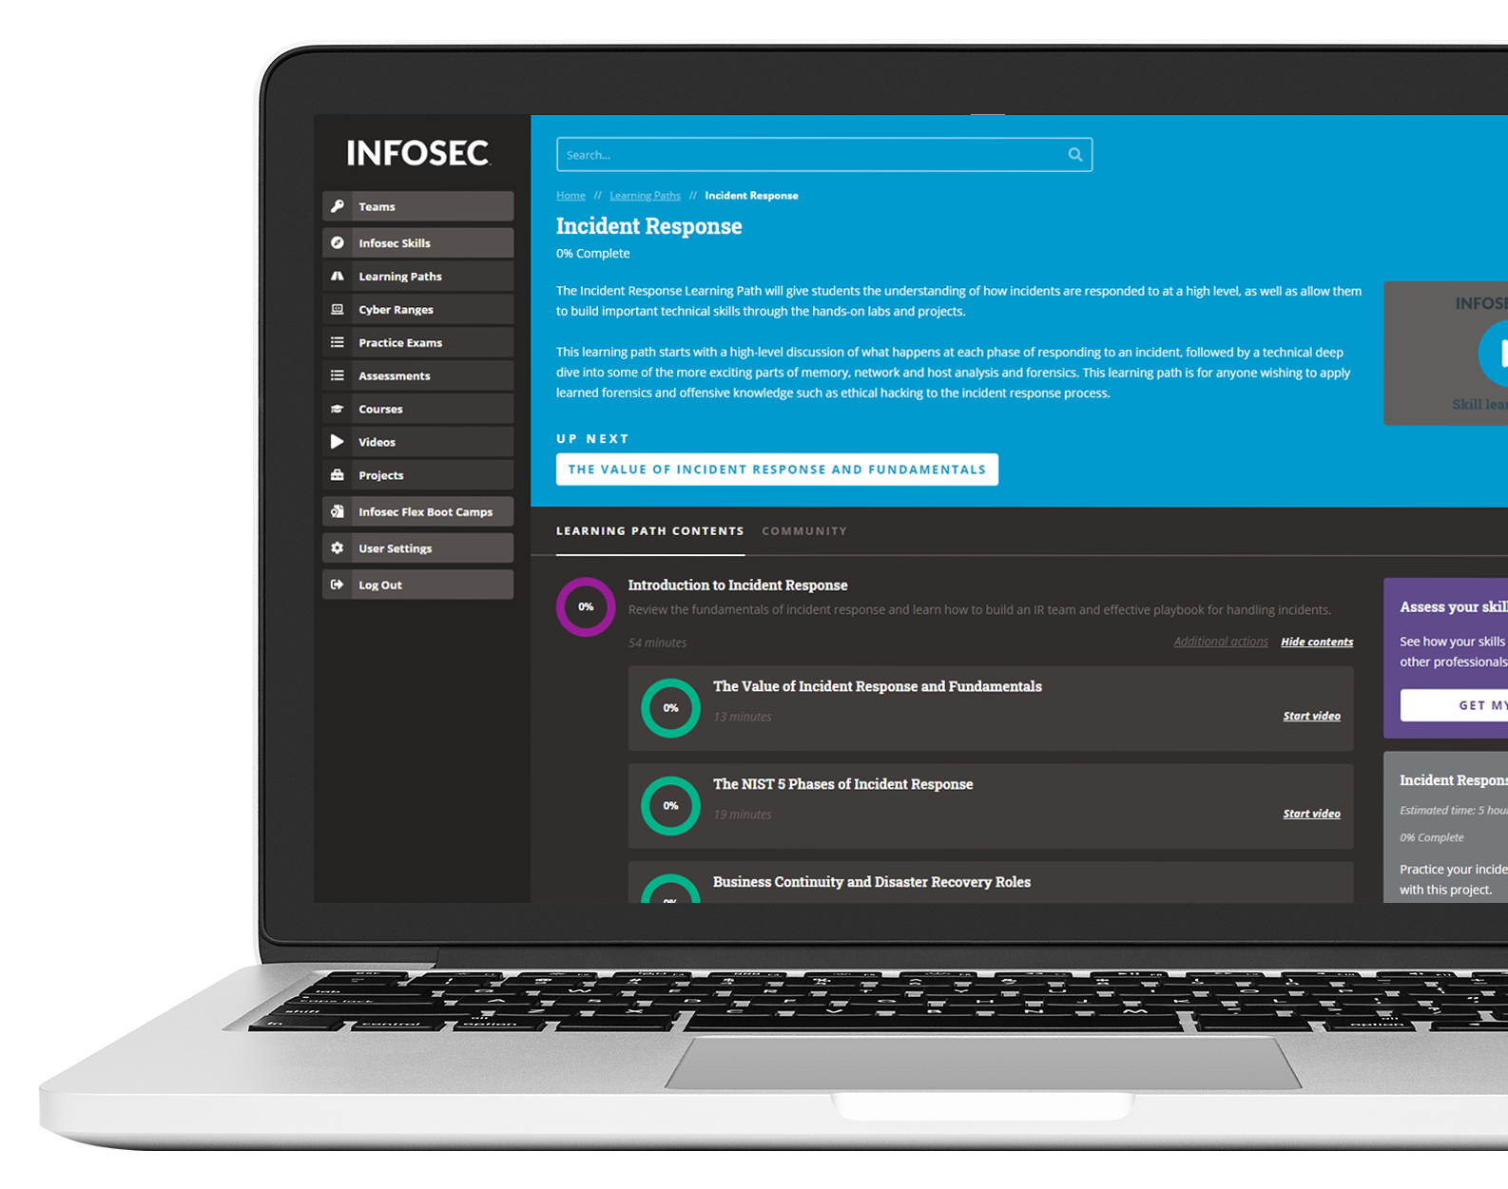
Educate & empower employees
Educate and engage your workforce
Deliver memorable campaigns with industry-leading content & assessments
350+ training modules in 34+ languages
Inspire better cybersecurity habits
Educate year-round and serve in-the-moment training for employees who need it most
1000+ phishing simulation templates with multiple attack types
Reduce security incidents
Avoid attacks and quickly respond to employee-reported events
Automated reporting button, reports and analytics
Build a culture of security
Go beyond awareness with a culture built to keep your organization secure
Program resources — posters, infographics, kits and more

Slide 65
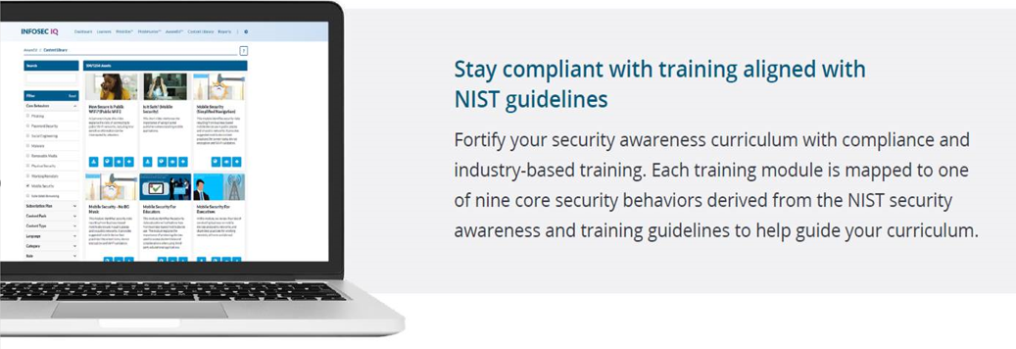

Slide 66
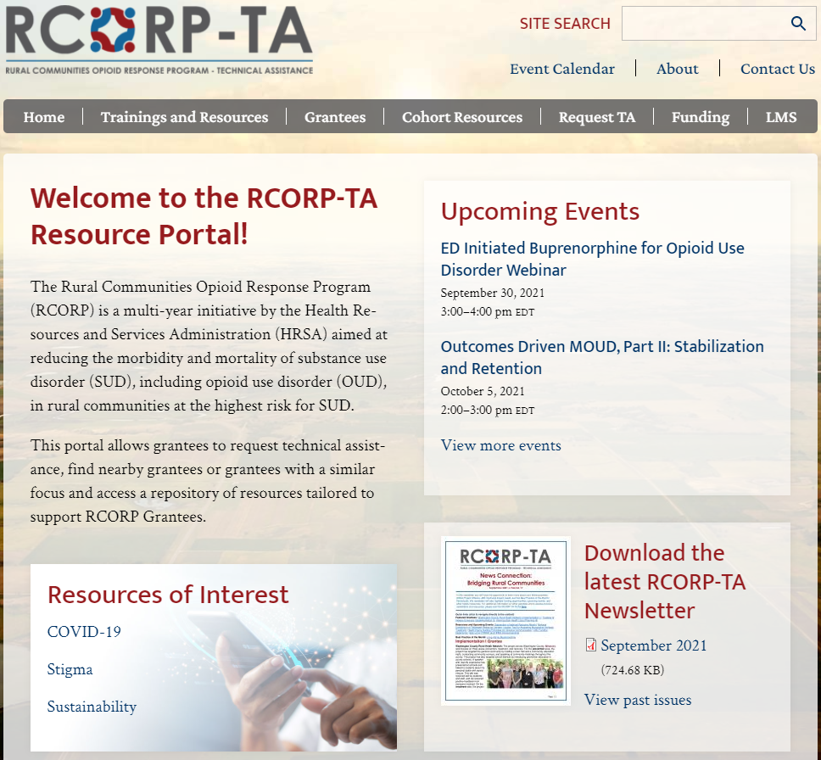
RCORP Resources For You
The RCORP-TA portal is publicly available and has information about programs, grantees, and various trainings and resources available.
https://www.rcorp-ta.org/

Slide 67
This project is supported by the Health Resources and Services Administration (HRSA) of the U.S. Department of Health and Human Services (HHS) as part of an award totaling $1,000,000 with zero percentage financed with non-governmental sources. The contents are those of the author(s) and do not necessarily represent the official views of, nor an endorsement, by HRSA, HHS, or the U.S. Government. For more information, please visit HRSA.gov.
Notes:
If speaker has no slides leave this slide up while they are speaking.

